Slide 1
tidyverse Package
Merrisa Lin
Notes:
Introduction to the specific package.
Definition, conceptual introduction, and motivation for the general topic that you are presenting.
Data cleaning, data manipulation, and data structures.
Discussion questions.
https://www.tidyverse.org/packages/

Slide 2
When having a big and messy dataset, what do you do?

Slide 3
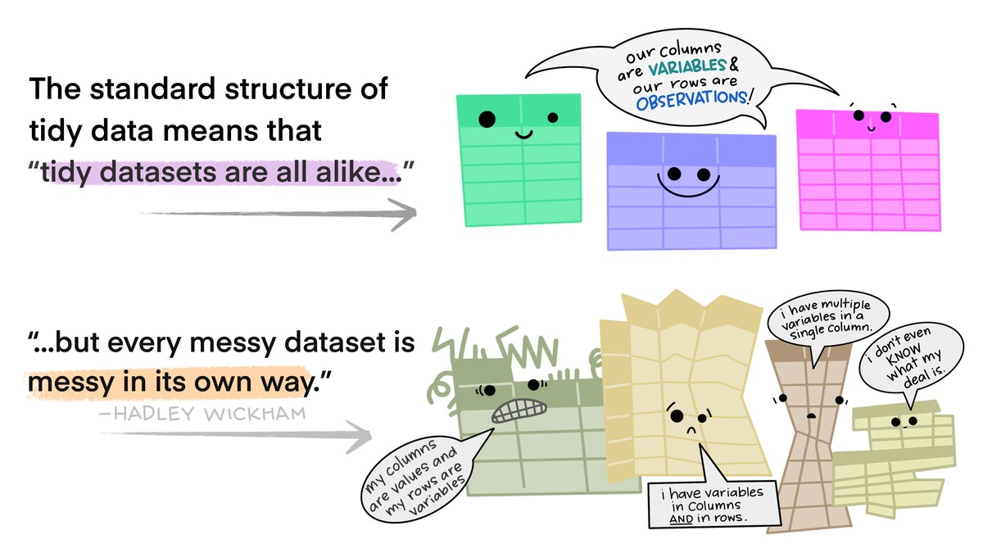

Slide 4
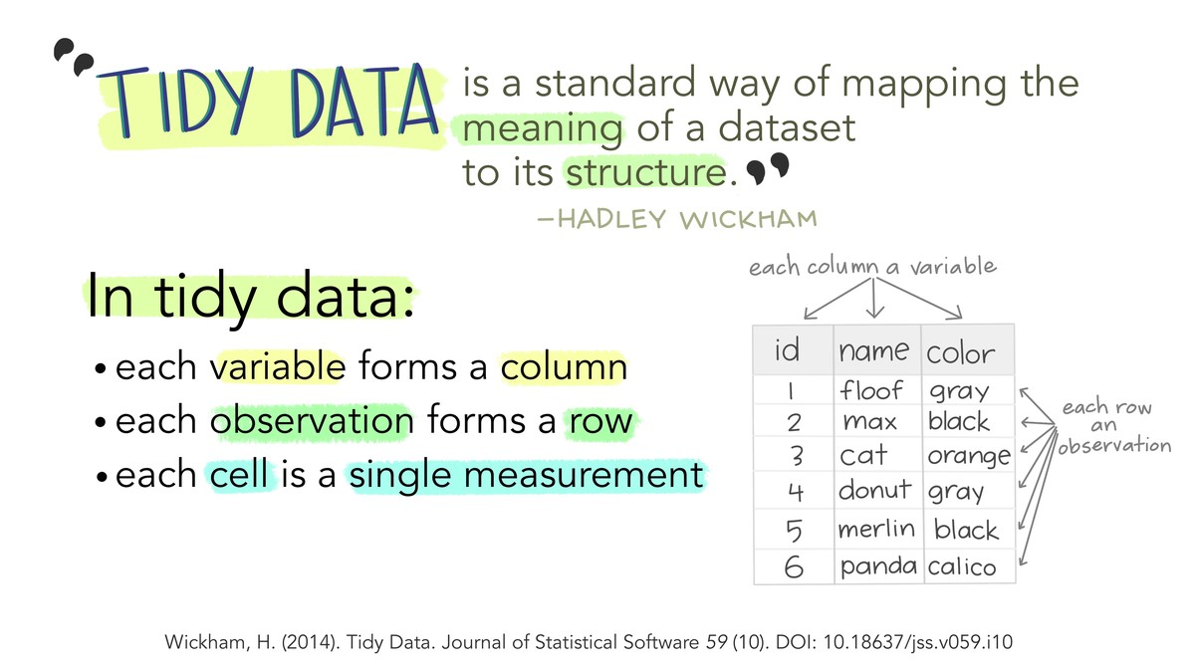
Notes:
the tidyverse is about the connections between the tools that make the workflow possible.

Slide 5
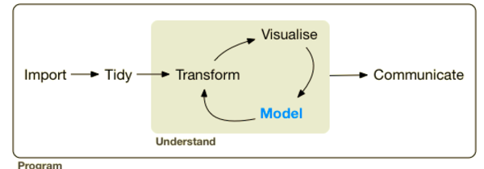
R Views. (2017). What is the Tidyverse? Retrieved February 9, 2022, from https://rviews.rstudio.com/2017/06/08/what-is-the-tidyverse/#:~:text=Tidyverse%20packages%20are%20intended%20to,that%20make%20the%20workflow%20possible.
Notes:
Tidyverse packages are intended to make statisticians and data scientists more productive by guiding them through workflows that facilitate communication, and result in reproducible work products.
Fundamentally, the tidyverse is about the connections between the tools that make the workflow possible.

Slide 6
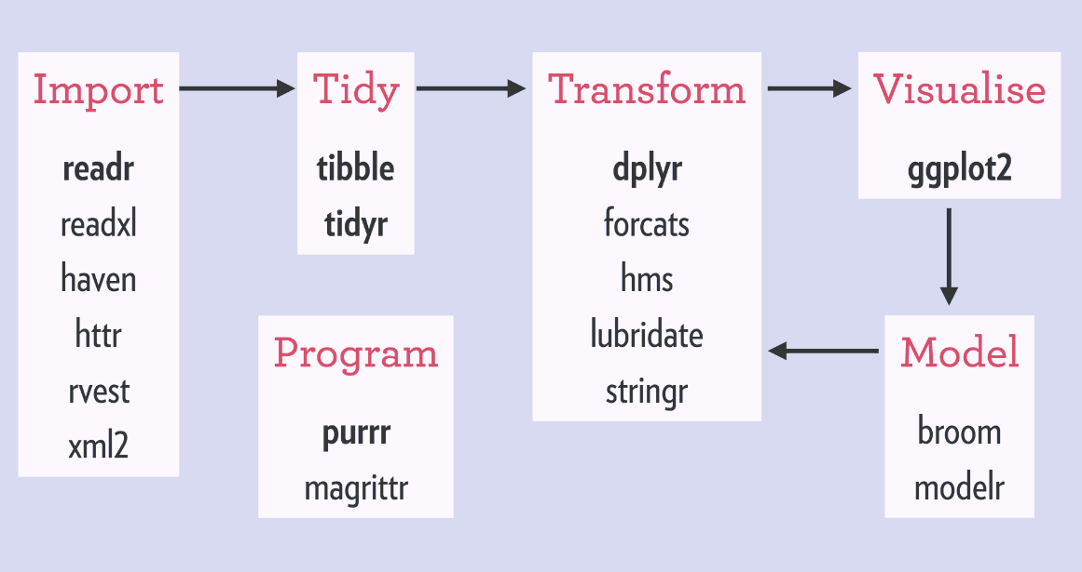
R Views. (2017). What is the Tidyverse? Retrieved February 9, 2022, from https://rviews.rstudio.com/2017/06/08/what-is-the-tidyverse/#:~:text=Tidyverse%20packages%20are%20intended%20to,that%20make%20the%20workflow%20possible.
Notes:
Tidyverse packages are intended to make statisticians and data scientists more productive by guiding them through workflows that facilitate communication, and result in reproducible work products.
Fundamentally, the tidyverse is about the connections between the tools that make the workflow possible.

Slide 7

readr
Read and call out the data files.
CSV, TSV, delimited files, fixed-width files, whitespace-separated files, web log files, SPSS, SAS, Stata, Excel.
Notes:
Import Data
readr, for data import.
Clean Data
tibble, for tibbles, a modern re-imagining of data frames.
tidyr, for data tidying.
Data Manipulation
dplyr, for data manipulation.
Data Structure
stringr, for strings.
forcats, for factors. R uses factors to handle categorical variables, variables that have a fixed and known set of possible values.
purrr, for functional programming. Enhances R’s functional programming (FP) toolkit by providing a complete and consistent set of tools for working with functions and vectors.
Data Visualization
ggplot2, for data visualization.

Slide 8
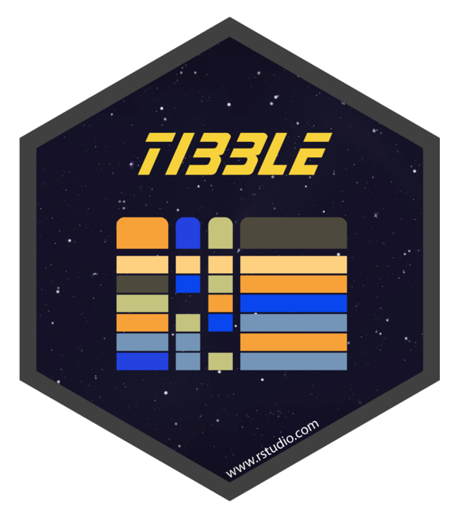
Tibble
Modern data frame.
Doesn’t change the input type nor variable name. Can have non-standard variable names. Doesn’t do partial matching.
Notes:
Import Data
readr, for data import.
Clean Data
tibble, for tibbles, a modern re-imagining of data frames.
tidyr, for data tidying.
Data Manipulation
dplyr, for data manipulation.
Data Structure
stringr, for strings.
forcats, for factors. R uses factors to handle categorical variables, variables that have a fixed and known set of possible values.
purrr, for functional programming. Enhances R’s functional programming (FP) toolkit by providing a complete and consistent set of tools for working with functions and vectors.
Data Visualization
ggplot2, for data visualization.

Slide 9

tidyr
Tidy the data files.
Every column is variable. Every row is an observation. Every cell is a single value.
Notes:
Import Data
readr, for data import.
Clean Data
tibble, for tibbles, a modern re-imagining of data frames.
tidyr, for data tidying.
Data Manipulation
dplyr, for data manipulation.
Data Structure
stringr, for strings.
forcats, for factors. R uses factors to handle categorical variables, variables that have a fixed and known set of possible values.
purrr, for functional programming. Enhances R’s functional programming (FP) toolkit by providing a complete and consistent set of tools for working with functions and vectors.
Data Visualization
ggplot2, for data visualization.

Slide 10

dplyr
Data manipulation.
Select, filter, manipulate the data file or variables you are interested in.
Notes:
Import Data
readr, for data import.
Clean Data
tibble, for tibbles, a modern re-imagining of data frames.
tidyr, for data tidying.
Data Manipulation
dplyr, for data manipulation.
Data Structure
stringr, for strings.
forcats, for factors. R uses factors to handle categorical variables, variables that have a fixed and known set of possible values.
purrr, for functional programming. Enhances R’s functional programming (FP) toolkit by providing a complete and consistent set of tools for working with functions and vectors.
Data Visualization
ggplot2, for data visualization.

Slide 11



Stringr
forcats
purrr
Manipulate string data.
Multiple functions for the string data (e.g., character count).
Notes:
Import Data
readr, for data import.
Clean Data
tibble, for tibbles, a modern re-imagining of data frames.
tidyr, for data tidying.
Data Manipulation
dplyr, for data manipulation.
Data Structure
stringr, for strings.
forcats, for factors. R uses factors to handle categorical variables, variables that have a fixed and known set of possible values.
purrr, for functional programming. Enhances R’s functional programming (FP) toolkit by providing a complete and consistent set of tools for working with functions and vectors.
Data Visualization
ggplot2, for data visualization.

Slide 12
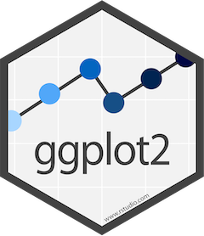
ggplot2
Creating graphics and visualizing data.
Provide the data, define what graphical primitives to use and how to map variables to aesthetics.
Notes:
Import Data
readr, for data import.
Clean Data
tibble, for tibbles, a modern re-imagining of data frames.
tidyr, for data tidying.
Data Manipulation
dplyr, for data manipulation.
Data Structure
stringr, for strings.
forcats, for factors. R uses factors to handle categorical variables, variables that have a fixed and known set of possible values.
purrr, for functional programming. Enhances R’s functional programming (FP) toolkit by providing a complete and consistent set of tools for working with functions and vectors.
Data Visualization
ggplot2, for data visualization.

Slide 13
Discussion: Can tidyverse package be used across different types of datasets?

